Slide 1
Ch6. Sorting(II)
Merge sort & quick sort

Slide 2
Merge two sorted lists
Lpos
Lpos
Rpos
Rpos
1
13
24
26
2
15
27
38
1
2
Tpos
Tpos
Tpos
T ( N ) = O ( ) where N is the total number of elements.
N
S ( N ) = O ( ) where N is the total number of elements.
N

Slide 3
Mergesort an array
If we start with an array in which the left half and the right half are sorted, we can merge them into a single sorted array
How did the left and right halves of our array get sorted?
  Obviously, by mergesorting them
  The base case: Mergesort an array of size 1
1
13
24
26
2
15
27
38

Slide 4
To mergesort an array:
  Devide the array into two halves
  Mergesort the left half
  Mergesort the right half
  Merge the two sorted halves
void MSort( ElementType A[ ], ElementType TmpArray[ ], int Left, int Right )
{ int Center;
if ( Left < Right ) { /* if there are elements to be sorted */
Center = ( Left + Right ) / 2;
MSort( A, TmpArray, Left, Center );
MSort( A, TmpArray, Center + 1, Right );
Merge( A, TmpArray, Left, Center + 1, Right );
}
}

Slide 5
Lpos
LefttEnd
Rpos
RightEnd
1
13
24
26
2
15
27
38
TmpArray[N]:
Tempos

Slide 6
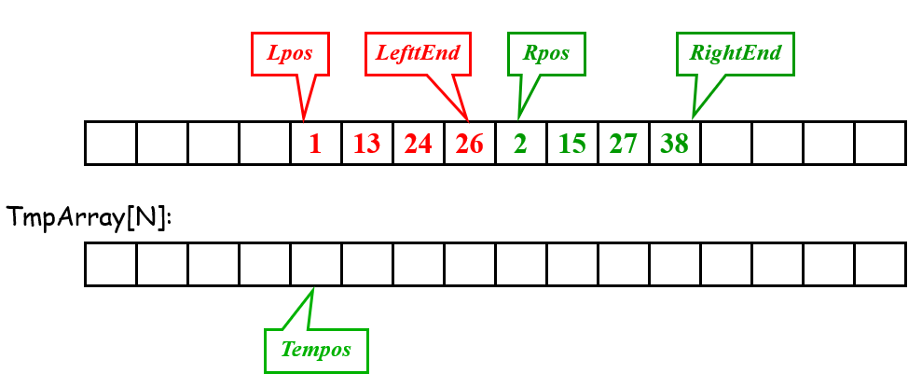
Merge:
/* Lpos = start of left half, Rpos = start of right half */
void Merge( ElementType A[ ], ElementType TmpArray[ ],
int Lpos, int Rpos, int RightEnd )
{
int i, LeftEnd, NumElements, TmpPos;
LeftEnd = Rpos - 1;
TmpPos = Lpos;
NumElements = RightEnd - Lpos + 1;
while( Lpos <= LeftEnd && Rpos <= RightEnd ) /* main loop */
if ( A[ Lpos ] <= A[ Rpos ] )
TmpArray[ TmpPos++ ] = A[ Lpos++ ];
else
TmpArray[ TmpPos++ ] = A[ Rpos++ ];
while( Lpos <= LeftEnd ) /* Copy rest of first half */
TmpArray[ TmpPos++ ] = A[ Lpos++ ];
while( Rpos <= RightEnd ) /* Copy rest of second half */
TmpArray[ TmpPos++ ] = A[ Rpos++ ];
for( i = 0; i < NumElements; i++, RightEnd - - )
/* Copy TmpArray back */
A[ RightEnd ] = TmpArray[ RightEnd ];
}

Slide 7
Mergesort:
void MSort( ElementType A[ ], ElementType TmpArray[ ],
int Left, int Right )
{ int Center;
if ( Left < Right ) { /* if there are elements to be sorted */
Center = ( Left + Right ) / 2;
MSort( A, TmpArray, Left, Center ); /* T( N / 2 ) */
MSort( A, TmpArray, Center + 1, Right ); /* T( N / 2 ) */
Merge( A, TmpArray, Left, Center + 1, Right ); /* O( N ) */
}
}
void Mergesort( ElementType A[ ], int N )
{ ElementType *TmpArray; /* need O(N) extra space */
TmpArray = malloc( N * sizeof( ElementType ) );
if ( TmpArray != NULL ) {
MSort( A, TmpArray, 0, N - 1 );
free( TmpArray );
}
else FatalError( "No space for tmp array!!!" );
}

Slide 8
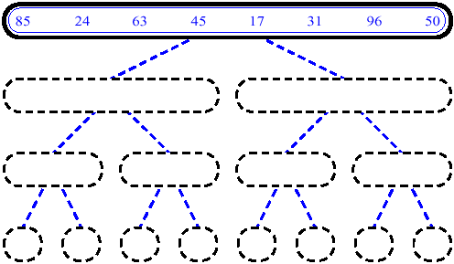
MergeSort (Example)

Slide 9
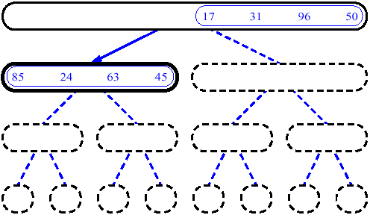
MergeSort (Example)

Slide 10
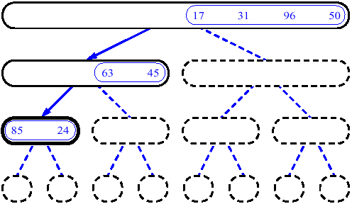
MergeSort (Example)

Slide 11
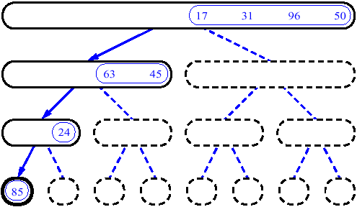
MergeSort (Example)

Slide 12
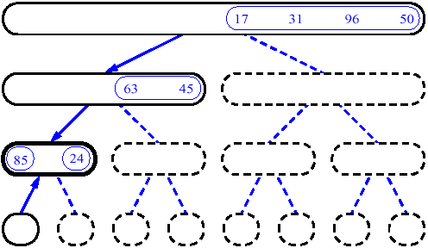
MergeSort (Example)

Slide 13
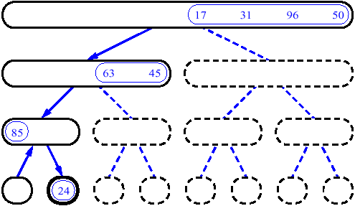
MergeSort (Example)

Slide 14
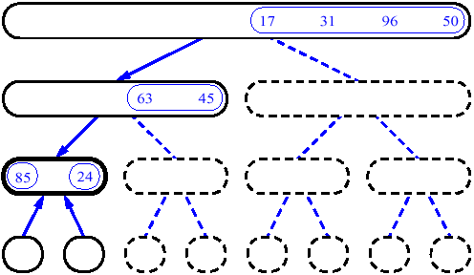
MergeSort (Example)

Slide 15
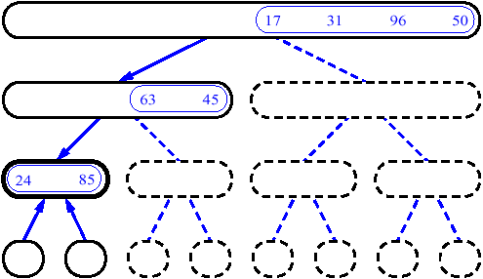
MergeSort (Example)

Slide 16
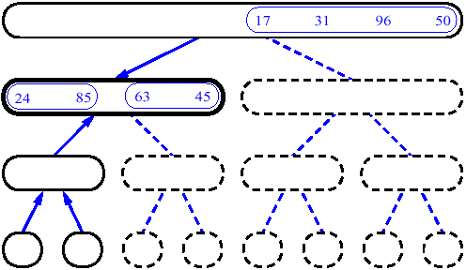
MergeSort (Example)

Slide 17
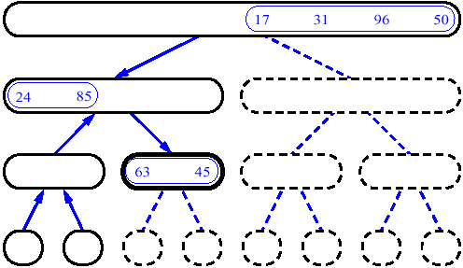
MergeSort (Example)

Slide 18
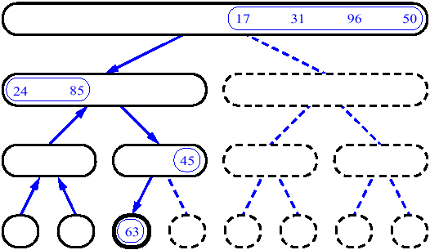
MergeSort (Example)

Slide 19
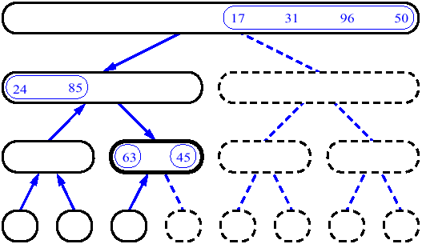
MergeSort (Example)

Slide 20
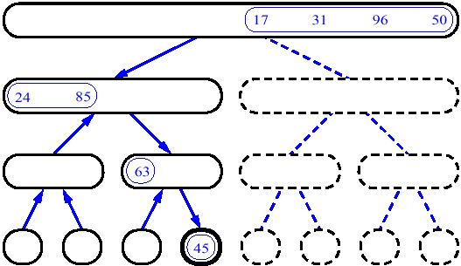
MergeSort (Example)

Slide 21
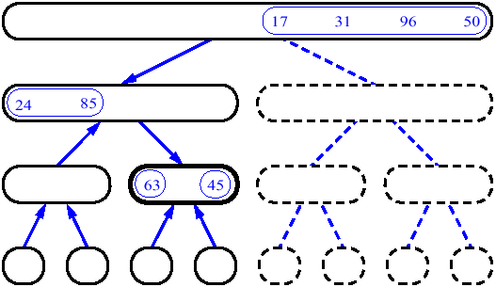
MergeSort (Example)

Slide 22
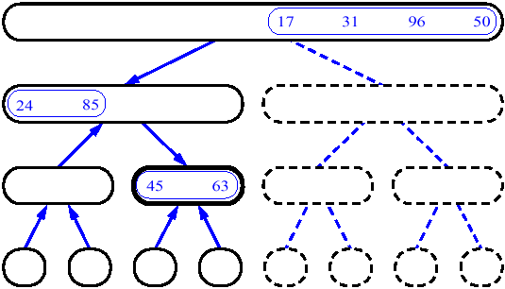
MergeSort (Example)

Slide 23
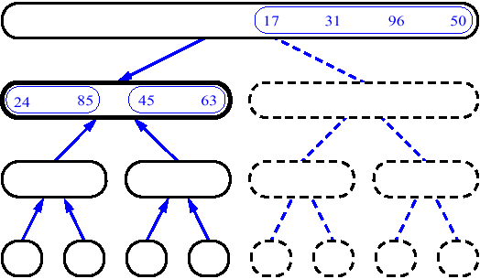
MergeSort (Example)

Slide 24
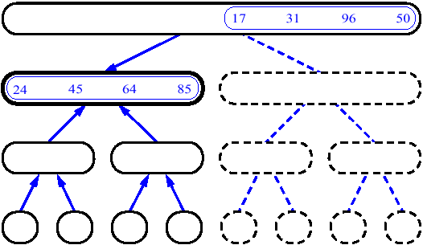
MergeSort (Example)

Slide 25
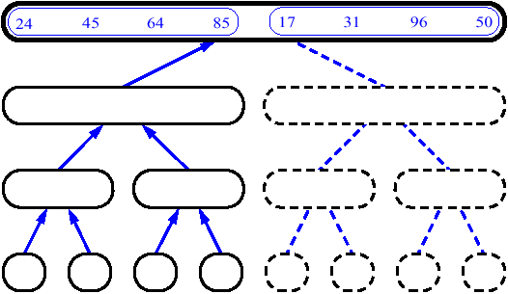
MergeSort (Example)

Slide 26
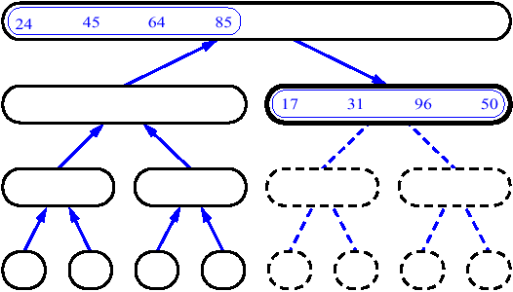
MergeSort (Example)

Slide 27
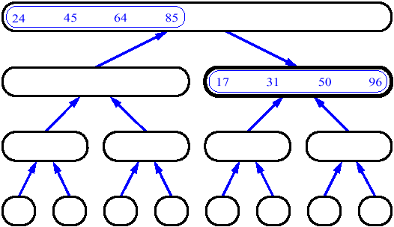
MergeSort (Example)

Slide 28
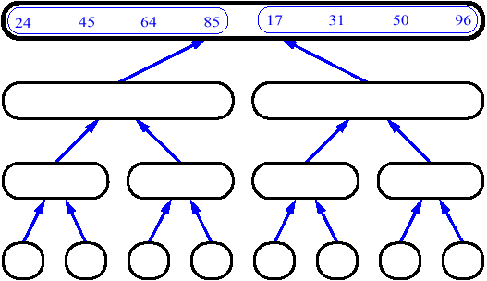
MergeSort (Example)

Slide 29
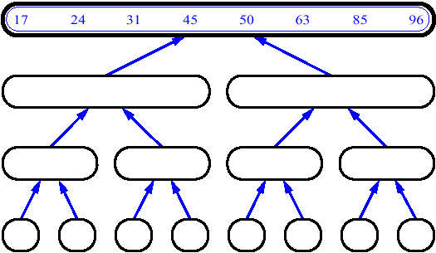
MergeSort (Example)

Slide 30
Mergesort:
void MSort( ElementType A[ ], ElementType TmpArray[ ], int Left, int Right )
{ int Center;
if ( Left < Right ) { /* if there are elements to be sorted */
Center = ( Left + Right ) / 2;
MSort( A, TmpArray, Left, Center ); /* T( N / 2 ) */
MSort( A, TmpArray, Center + 1, Right ); /* T( N / 2 ) */
Merge( A, TmpArray, Left, Center + 1, Right ); /* O( N ) */
}
}
If a TmpArray is declared locally for each call of Merge, then S(N) = ?
If a TmpArray is declared locally in function merge:
S(N) =O(NlogN)

Slide 31

Analysis
T ( 1 ) = 1
Note: Mergesort requires linear extra memory, and copying an array is slow. It is hardly ever used for internal sorting, but is quite useful for external sorting.
T ( N ) = 2T ( N / 2 ) + O( N )
= 2^{k} T ( N / 2^{k} ) + k * O( N )
= N * T ( 1 ) + log N * O( N )
= O( N + N log N )
Iterative version :
A
85
24
63
45
17
31
96
50
24 85
45 63
17 31
50 96
24 45 63 85
17 31 50 96
17 24 31 45 50 63 85 96

Slide 32
Quicksort
⬧
Choose some element called a pivot(枢轴）
Perform a sequence of exchanges so that
  All elements that are less than this pivot are to its left and
  All elements that are greater than the pivot are to its right.
The pivot is placed at the right place once and for all
Divides the (sub)list into two smaller sub lists
Each of which may then be sorted independently in the same way.
⬧
Little
Big
Pivot

Slide 33

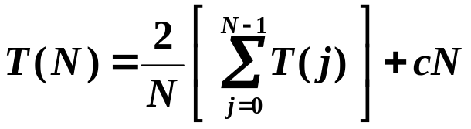
Analysis
T( N ) = T( i ) + T( N – i – 1 ) + c N
☞ The Worst Case:
Little
T( N ) = T( N – 1 ) + c N
T( N ) = O( N² )
☞ The Best Case:
Little
Big
T( N ) = 2T( N / 2 ) + c N
T( N ) = O( N log N )
☞ The Average Case:
Assume the average value of T( i ) for any i is
T( N ) = O( N log N )

Slide 34








Partitioning Strategy
<
>
>
<
<
>
<
<
<
<
>
8
2
1
4
9
5
0
3
5
9
6
2
8
7
6
9
i
i
i
i
i
i
j
j
j
i
j
Not too difficult if we carefully
implement it…
Uh-oh, there will be many dummy swaps…
But hey! At least the sequence will be
partitioned into two equal-sized
subsequences.
No swap… but then T( N ) = …
Then T( N ) = O( N² ).
So we’d better stop both i and j
and take some extra swaps.
What will happen to
the sequence:
1, 1, 1, …, 1 ?
Good point!
How about the other option –
that neither i nor j stops?
What if there is a
key == pivot?
How about stop i and j both
and then swap?

Slide 35
Partitioning Strategy
8
1
4
9
0
3
5
2
7
6
i
j
1. Initialize i=left and j=right-1
2. Increase i, when the element pointed by i ≥ the pivot, stop i
3. Decrease j, when the element pointed by j ≤ the pivot, stop j
4. if i<j, swap the elements pointed by i and j, goto step 2.
Otherwise, swap element pointed by i and the pivot, then stop.

Slide 36

Picking the Pivot
☞ A Wrong Way:
Pivot = A[ 0 ]
The worst case:
A[ ] is presorted – quicksort will
☹ take O( N² ) time to do nothing
☞ A Safe Maneuver:
Pivot = random select from A[ ]
☹ random number generation is expensive
☞ Median-of-Three Partitioning:
Pivot = median ( left, center, right )
Eliminates the bad case for sorted input and actually reduces the running time by about 5%.

Slide 37
/* Return median of Left, Center, and Right */
/* Order these and hide the pivot */
ElementType Median3( ElementType A[ ], int Left, int Right )
{
int Center = ( Left + Right ) / 2;
if ( A[ Left ] > A[ Center ] )
Swap( &A[ Left ], &A[ Center ] );
if ( A[ Left ] > A[ Right ] )
Swap( &A[ Left ], &A[ Right ] );
if ( A[ Center ] > A[ Right ] )
Swap( &A[ Center ], &A[ Right ] );
/* Invariant: A[ Left ] <= A[ Center ] <= A[ Right ] */
Swap( &A[ Center ], &A[ Right - 1 ] ); /* Hide pivot */
/* only need to sort A[ Left + 1 ] … A[ Right – 2 ] */
return A[ Right - 1 ]; /* Return pivot */
}

Slide 38
Small Arrays
Problem: Quicksort is slower than insertion sort for small arrays N ( ≤ 20 ).
Solution: Cutoff when N gets small ( e.g. N = 10 ) and use other efficient algorithms (such as insertion sort).

Slide 39
void Qsort( ElementType A[ ], int Left, int Right )
{ int i, j;
ElementType Pivot;
if ( Left + Cutoff <= Right ) { /* if the sequence is not too short */
Pivot = Median3( A, Left, Right ); /* select pivot */
for( ; ; ) {
if ( i < j )
Swap( &A[ i ], &A[ j ] ); /* adjust partition */
else break; /* partition done */
}
Swap( &A[ i ], &A[ Right - 1 ] ); /* restore pivot */
Qsort( A, Left, i - 1 ); /* recursively sort left part */
Qsort( A, i + 1, Right ); /* recursively sort right part */
} /* end if - the sequence is long */
else /* do an insertion sort on the short subarray */
InsertionSort( A + Left, Right - Left + 1 );
}
i = Left+1; j = Right – 2;
while ( A[ i+ + ] < Pivot ) ;
while ( A[ j - - ] > Pivot ) ;
void Quicksort( ElementType A[ ], int N )
{
Qsort( A, 0, N - 1 );
}

Slide 40
Quicksort
A more efficient exchange sorting scheme than bubble sort
  A typical exchange involves elements that are far apart
  Fewer interchanges are required to correctly position an element.
Quicksort uses a divide-and-conquer strategy
  A recursive approach
  The original problem partitioned into simpler sub-problems,
  Each sub problem considered independently.

